Slide 1

Improving Federal Grants Management
Shelley Metzenbaum
The BETTER Project
(Bringing Everyone Together To Enhance Results)
BETTERproject.info
OMB/Grants CAP Goal Innovation Exchange
May 20, 2021

Slide 2
IBM Federal Grants Management Report + 2 white papers
Grants Management: Improve Outcomes
http://www.businessofgovernment.org/sites/default/files/Federal%20Grants%20Management_0.pdf
Grants Management : Improve Operational Quality (service, stewardship)
http://www.businessofgovernment.org/sites/default/files/Improving%20Operational%20Quality.pdf
Grants Management : Improve Transparency (to improve outcomes & operational quality, strengthen accountability, build understanding of and trust in government)
http://www.businessofgovernment.org/sites/default/files/Improving%20Transparency.pdf

Slide 3
Areas of Opportunity for Improvement
Q’s grant programs, grantees, policy makers ask
Where to focus and how to improve
What works, what works better, and in which situations
Outcome progress made, problems needing attention
Data, analytics, and well-designed trials
People – roles, responsibilities, skills
Communication & community – to improve, strengthen accountability, build understanding of government
Processes and routines – connect people with each other & w/ relevant evidence to understand evidence, decide next steps
Accountability expectations and incentive structures

Slide 4
Report and White Paper Content
Identify issues needing attention and opportunities for improvement
Find examples worth continuing and copying
Encourage the search for even better practices
Identify past problems to avoid
Recommendations for future improvement:
Grant programs, especially but not only outcome brokers
Cross program action to support learning and collaboration
OMB
Others
GAO and other oversight bodies

Slide 5
Why Focus on Grants
$765 billion annually before Covid, , 30% > contracts!
More than $ value – leverage additional in-kind, financial investment
~ 1700 grant programs
Grants management has historically gotten little attention
e.g., GPRAMA mandates priority goals in 5 mgt areas, but not grants
3 federal “acquisition” universities; none for grants
Attention more to grant spending, closeouts, non-compliance, and other problems than to outcomes (trends, accomplishments) and improvement opportunities
Happily, starting to change
Multiple laws increase focus on grants and outcomes including GPRAMA, Foundations of Evidence Act, DATA Act, GREAT Act, Taxpayer RTK Act, and more!
Grants CAP Goal & Grants Playbook call for rebalancing

Slide 6
Manage Grants to Improve Outcomes First and Foremost
Easy to say, but hard to do
Lack of clarity about outcome objectives and responsibility for outcome improvement
Difficulty finding and sharing relevant data
Emphasis imbalance: oversight infrastructure overwhelms insight-generating infrastructure evident in words and steps in OMB/GAO grant life cycle charts
Data & analytic advances create unprecedented opportunities for outcome improvement
Also need attention to:
People
Communication and community
How data and other evidence are used

Slide 7
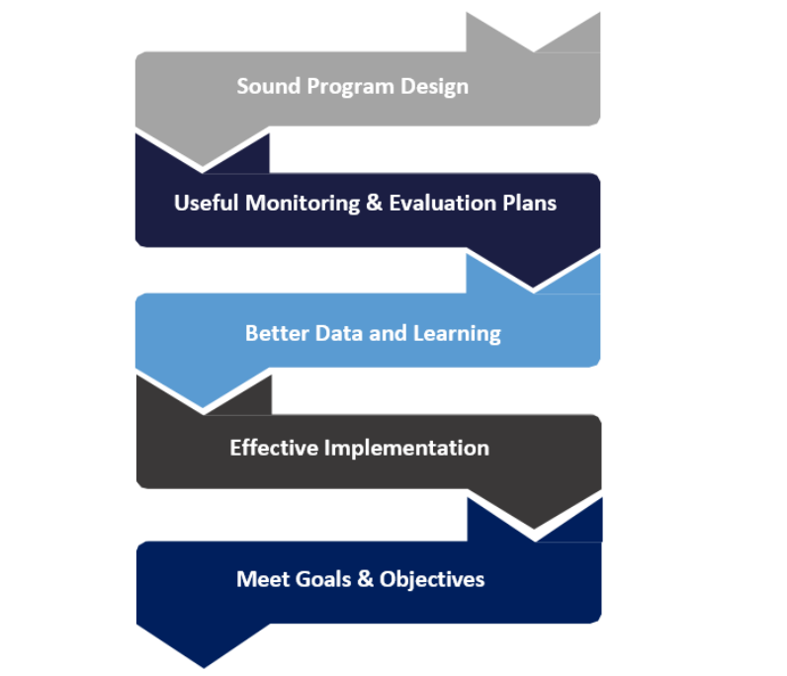
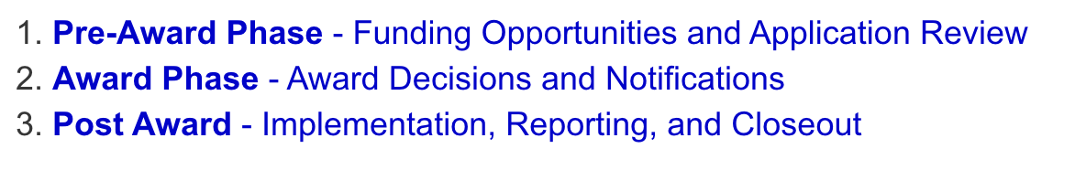
Graphics & words matter. From oversight to insight generation, from using assessments to judge to using them to find ways to improve; making progress on goals, not meeting them all.
Grants Playbook => State Department language
Grants.gov, GAO language
Reviewing reports
Site visits
Audits
https://www.state.gov/wp-content/uploads/2018/12/Program-Design-and-Performance-Management-Toolkit.pdf

Slide 8
Manage Grants to Improve Outcomes Find, Build, Share, Analyze & Use Evidence
What is evidence – data analytics, not just evaluation
Evaluation not to find and fund what works but what works and what works better, situational differences affecting effectiveness, lessons from failed trials
Also, evidence to inform where to focus, both action and knowledge building
For 3 distinct purposes – to:
Inform where to focus – which problems/opportunities get attention long & short term (grant program/grantee/community goal setting)
Find ways to improve
Positive outliers and other useful analyses
Those outperforming peers in recent periods and growth – “Moneyball players” to learn from or hire
Other useful analytic methods inc.: correlation for prediction, causal factors can influence, clusters, sudden or unexpected change, anomalous statistics
Well-designed trials – RCTs, trials integrated into operations (structure of collected data matters)
Increase uptake of better practices (+ products & providers), reduce use of less good ones
Effective, cost-effective, equitable data and evidence sharing to improve outcomes/op. quality
Find, build, share, use evidence about successful knowledge diffusion and uptake practices

Slide 9
Grants Management : Improve Operational Quality
Service
Grant recipients a service priority
Process quality
Knowledge relevance and diffusion
Beneficiaries
Others
Stewardship
Cost effectiveness
Wise risk management
Bias management
Data collection, analytics, and communication important to improve op quality, too, within and across grant programs

Slide 10
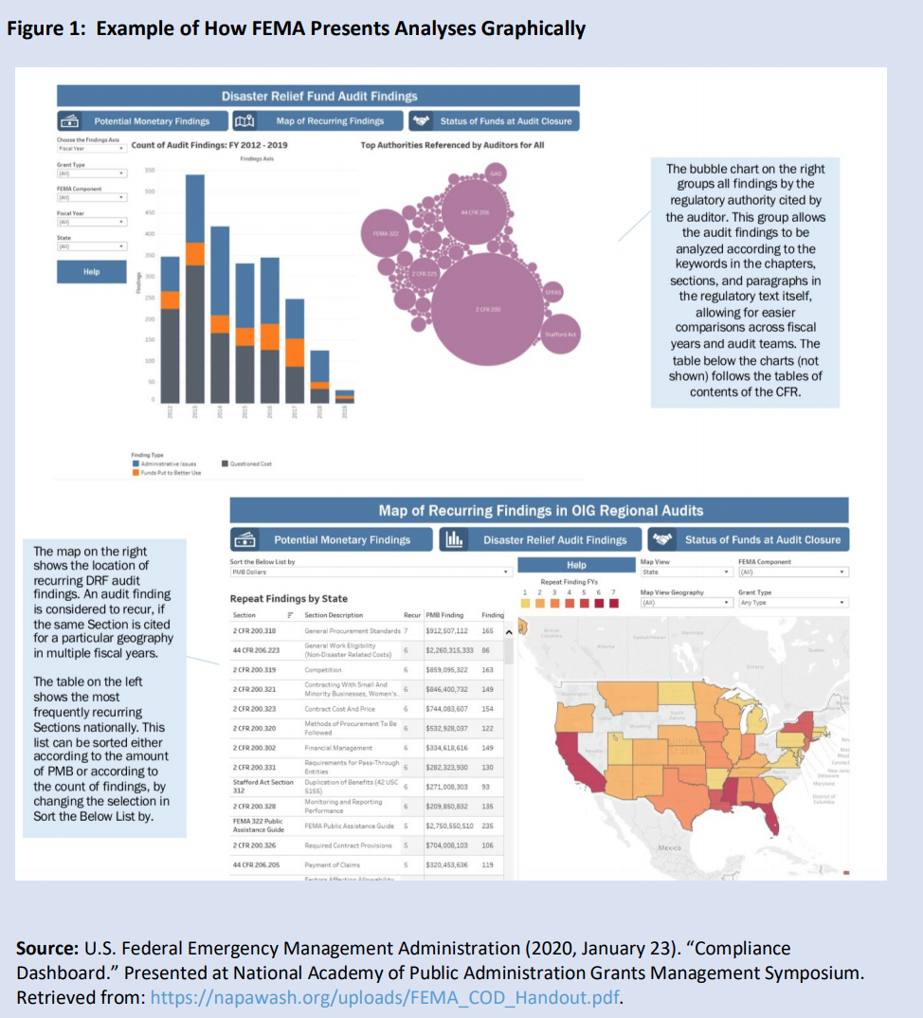
Systematically code, analyze, and communicate monitoring & audit info to reduce non-compliance problems (confirming compliance requirements align with real-world risks)

Slide 11
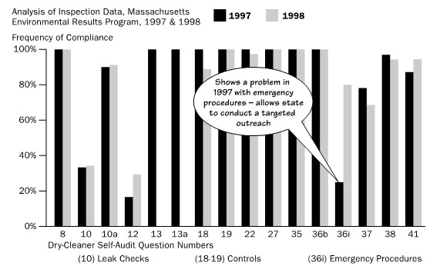
Analyze and communicate monitoring/inspection findings to inform where to focus and find if actions taken worked as hoped (of grantees and help grantees)

Slide 12
Grants Management: Improve Transparency
Communicate to:
Improve outcomes and operational quality
Analyses
Findings of well-designed trials (RCTs, integrated into operations), other studies that inform focus and trial design – and not just averages
Strengthen accountability
Mutual – grantor and grant recipients and other goal allies (who will do what when and why)
Democratic – what goals, measures, and strategies are, why they were chosen, and planned next steps to support democratic debate about these
Performance – not accountable for meeting targets or doing better than others but for using and communicating data and other evidence to inform focus, find ways to improve, and increase adoption of better practices
Build understanding of and trust in government
Ridiculously hard to find trends, other accomplishments of grant programs

Slide 13
Data viz, shared platforms and research to inform focus, find ways to improve, increase uptake-e.g.,
Within and across
Individual grant programs can help grant recipients
Decide where to focus within grant program’s outcome goals
Improve outcomes
Enlist and engage support
Grant programs can help each other help grant recipients improve
Coordinate and learn on shared outcome objectives, beneficiaries
Share analytic and visualization methods
Find, build, share evidence about evidence repositories, T/TA, other uptake promoting methods sortable by audience and goal type
Grants Playbook and guidance evolution – v. 2 and beyond?
Find and share examples + how-to’s
Evolved guidance and playbook formats using user-centered design principles
Share platforms - NASA use of PubMed, ClinicalTrials.gov, dynamic learning agendas

Slide 14
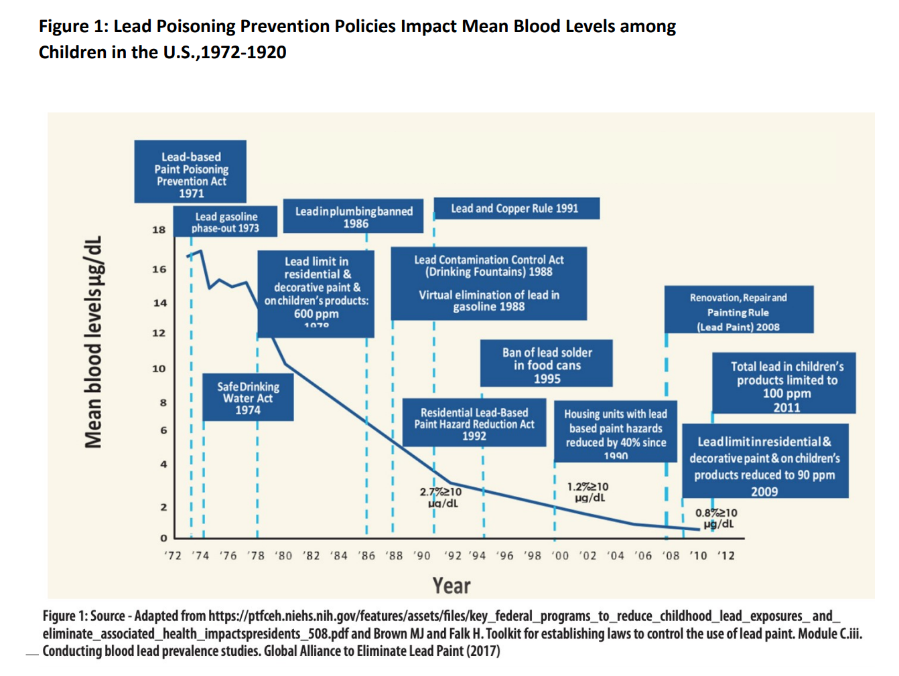
Communicate to Build Understanding of and Trust in Government + Inform Focus: NOFO linked to action plan indicating next steps plus narrative, visualization of past progress showing likely contributing government actions

Slide 15
Trends to which grant programs contribute: Can we make trends and accomplishment lists easier to find? (EPA annual performance report)

Slide 16
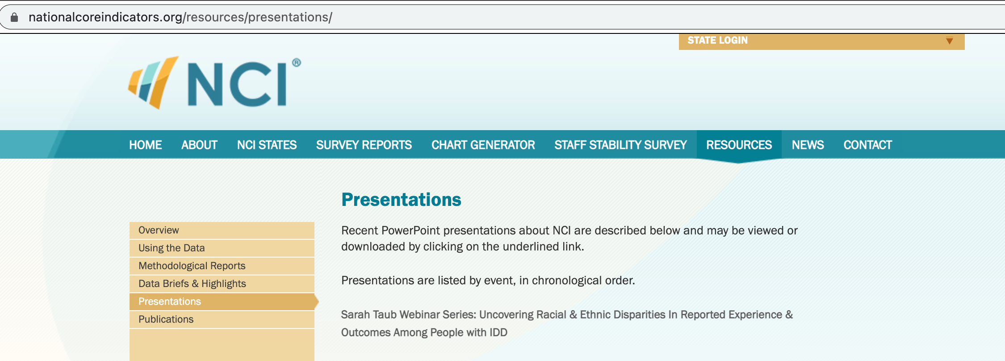
Communicate to help grant recipients decide where to focus, find ways to improve, enlist and engage support, increase use of better practices

Slide 17
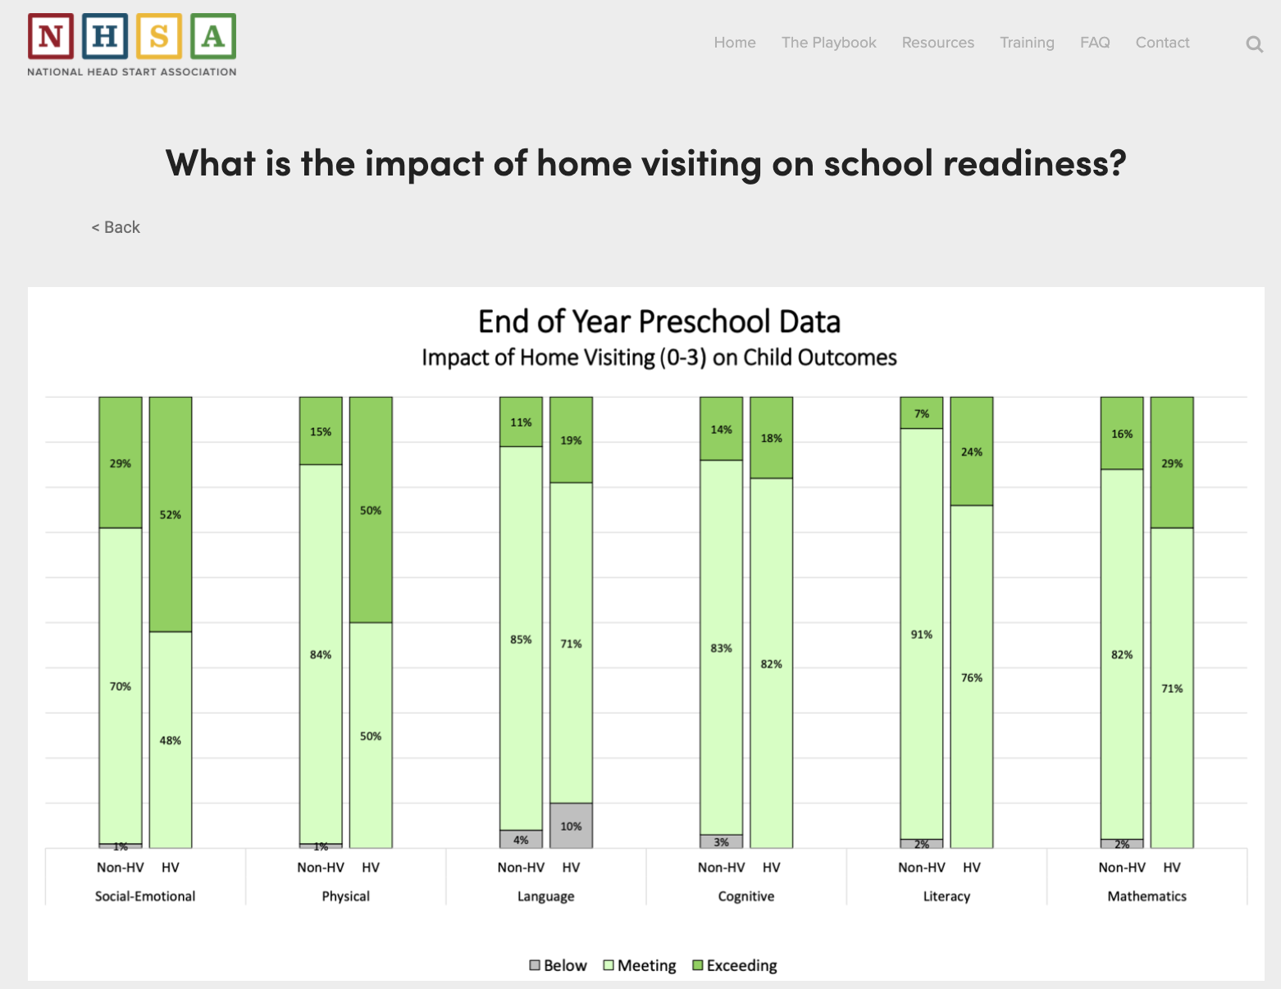
Grant recipient network finding, building, and sharing analytic capacity to find ways to improve and inform where to focus (data.nhsa.org)

Slide 18
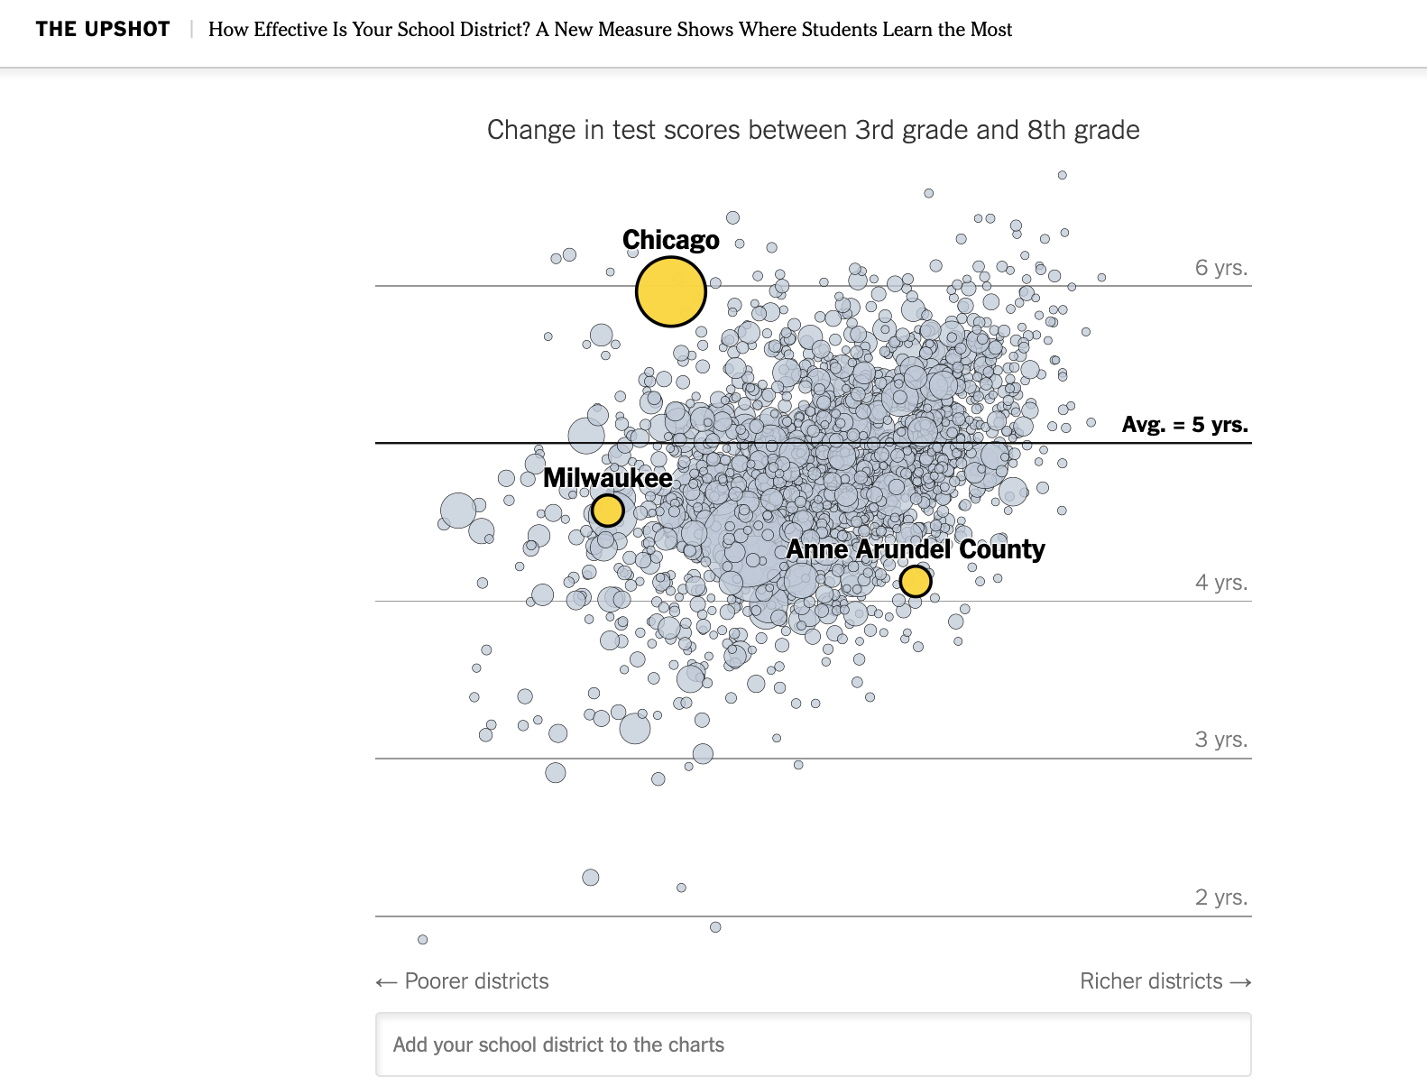
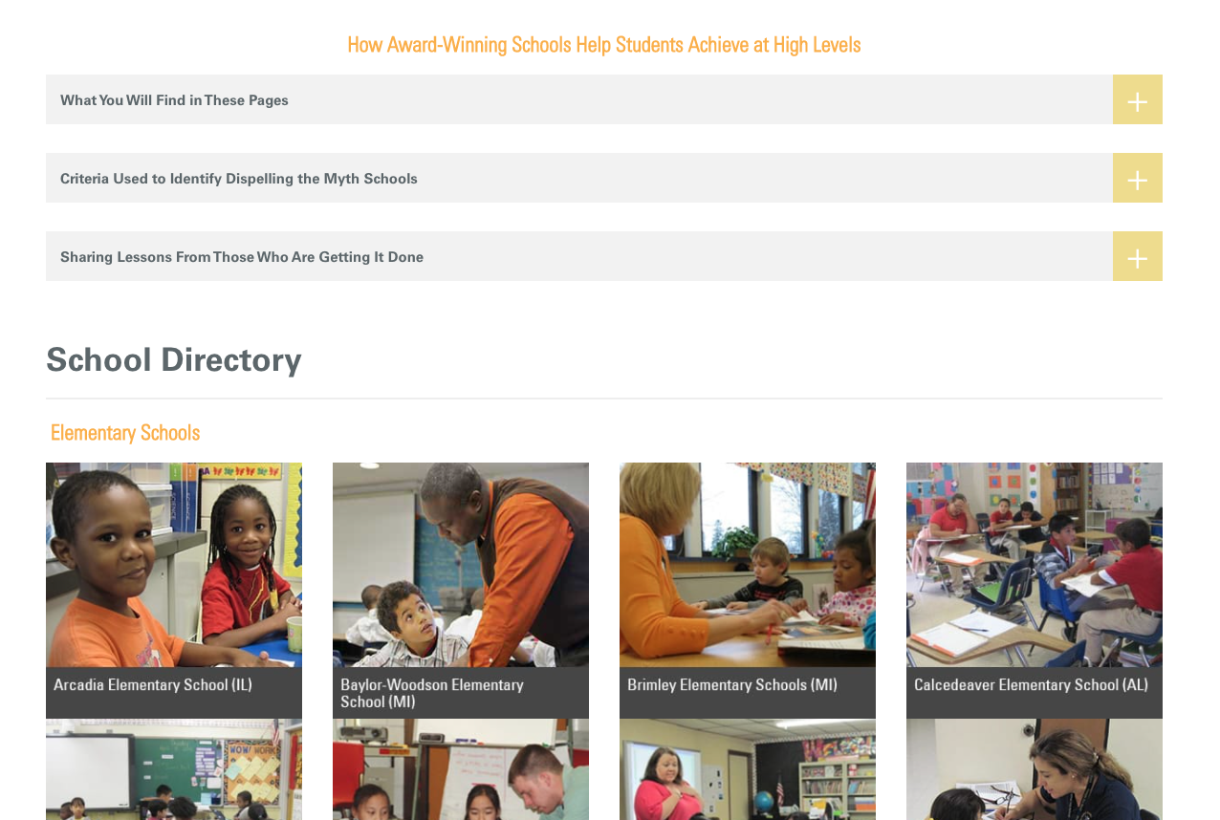
External NGO s, researchers, journalists search for positive outliers w/ fed $. But who and how used?
https://edtrust.org/dispelling_the_myth/
https://www.nytimes.com/interactive/2017/12/05/upshot/a-better-way-to-compare-public-schools.html

Slide 19
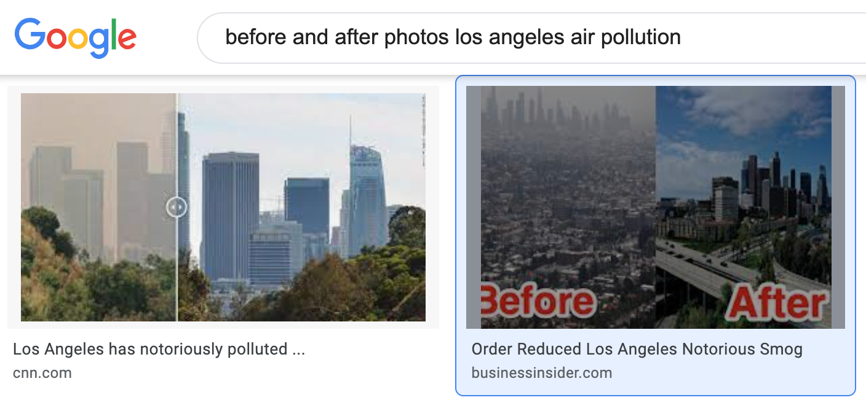
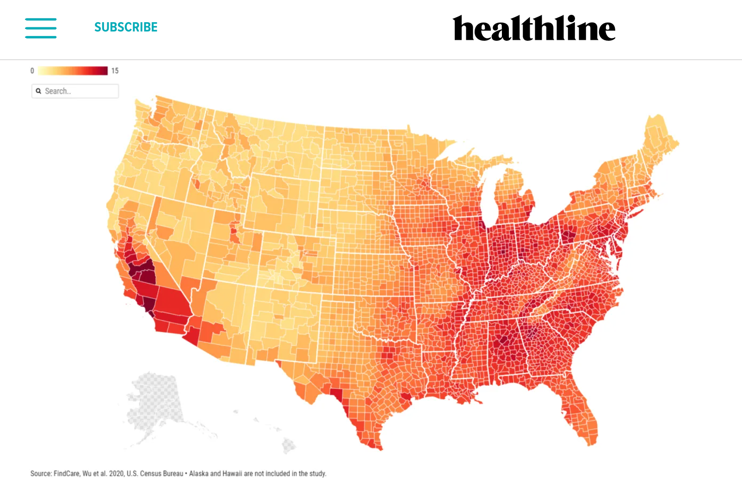
Communicate using photos, maps re progress, lack of it, who not managing w/ data (Flint MI drinking water, WV opioid use) + build/share evidence on effective data communication for increased use by target audiences
https://www.drugabuse.gov/drug-topics/opioids/opioid-summaries-by-state/west-virginia-opioid-involved-deaths-related-harms

Slide 20
Federal grants management: Improve Transparency
Nominate
Illuminate
Motivate
Allocate
Stimulate innovation
Enlist and engage
Inform choice of goals and better practices, products, providers
Build understanding of and, I hope, trust in government

Slide 21
What data and how data are collected, shared, analyzed, used matters
Data standards recommended
Outcome categories to facilitate collaboration around outcomes, strengthen democratic and performance accountability, build public understanding
Goal types and grant mechanism categories to build and share knowledge about effective grant practices
Operational risk categories to manage risk, bias, cost-effectiveness and learn across programs
Add unique grant program identifiers to outcome info – data systems, evidence repositories, learning agendas
Structure data to facilitate learning, improvement, community
Timing, timelines, temporal and geographic frequency
Granularity/units of analyses
Data analytic capacity needed
Within and across grant programs and agencies
For shared outcomes and common processes
Knowledge communication capacity to policy makers, field, public needed

Slide 22
Manage Grants to Improve Outcomes and Op. Qual. People, Accountability, Incentives
People – evolving roles for federal officials
Outcome brokers
Problem solvers and opportunity pursuers
Continuous-learning-and-improvement communities organized around outcomes – nurture and create where needed
Identify and network outcome brokers and others working on outcomes improvement
Effective communication (transparency)
Key users and uses
Find, build, share, and use evidence to boost use of shared evidence
Evidence-informed accountability expectations and incentive structures

Slide 23
Questions? Concerns? Suggestions? Ready to lead progress or contribute to progress on next steps?
Contact me via:
BETTERproject.info
(Please be patient if it takes a while to respond.)
…and work with each other!!!

